Slide 1
US Prevailing Wages
Team 3: Yash Wali, Sijie Wang, Joshua Puram, Pradyumn Pottapatri, Samir Basu

Slide 2
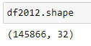
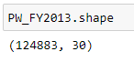
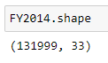
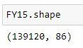
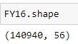
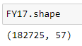
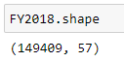
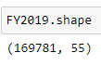
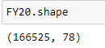
Preprocessing
Common Columns
CASE_NUMBER
PW_DETERMINATION_DATE
EMPLOYER_CITY
EMPLOYER_STATE
EMPLOYER_POSTAL_CODE
NAIC_US_CODE
PRIMARY_EDUCATION_LEVEL
EMP_EXPERIENCE_MONTHS
PWD_SOC_CODE_TITLE
PWD_WAGE_RATE
Eight Years of Data
There are ten datasets, nine of which cover immigration employment data from 2012 to 2020
Tenth was 2020 worksite location data
US Dept of Labor: Office of Foreign Labor Certification
Each dataset had between 33-86 columns, with up to 160,000 rows of data
Despite having the same content, column names were inconsistent
10 Common Columns:
Isolated 10 common columns that would be the most useful for our analysis, and existed in all the disclosure datasets
Factors included quantity of usable data and if the column could uniquely identify something about the data
Notes:
Speaker: Samir

Slide 3
Preprocessing
Preprocessing Steps
Identified 10 common columns for analysis
Duplicated copies of the original datasets as part of error catching
Removed problematic rows
Retained the 10 common columns
Renamed columns for consistency and concatenation
Concatenation
Additional steps were taken by each member to prepare the data
Goal was to concatenate the datasets into a single data frame so we could analyze 8 years of data

Slide 4
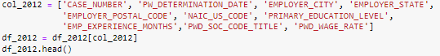
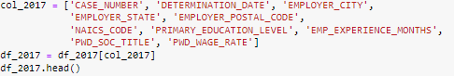
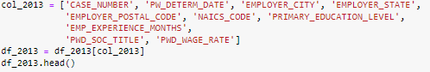
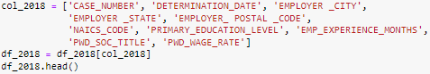
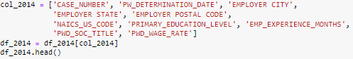
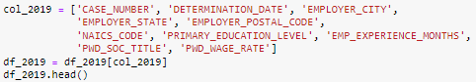
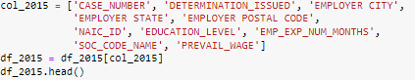
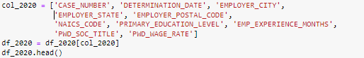
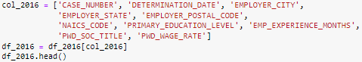
Preprocessing

Slide 5
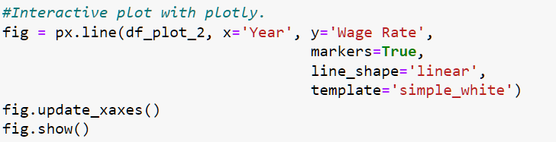
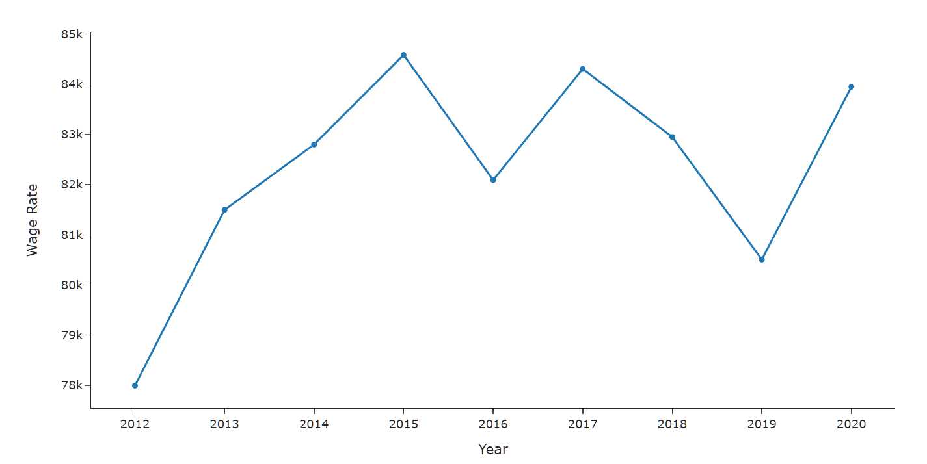
Wage Growth
Trend:
“In 2015 the U.S. economy was so slow that several historically-reliable indicators of an imminent recession were waving red flags.
Industrial Production was negative over 12 months, and retail sales growth was falling. The global economy was even weaker. By early 2016, global stock markets were falling hard.”
Carlson Bob, “Are We Repeating 2015-2016 In The Economy And Investment Markets?”, Forbes.

Slide 6
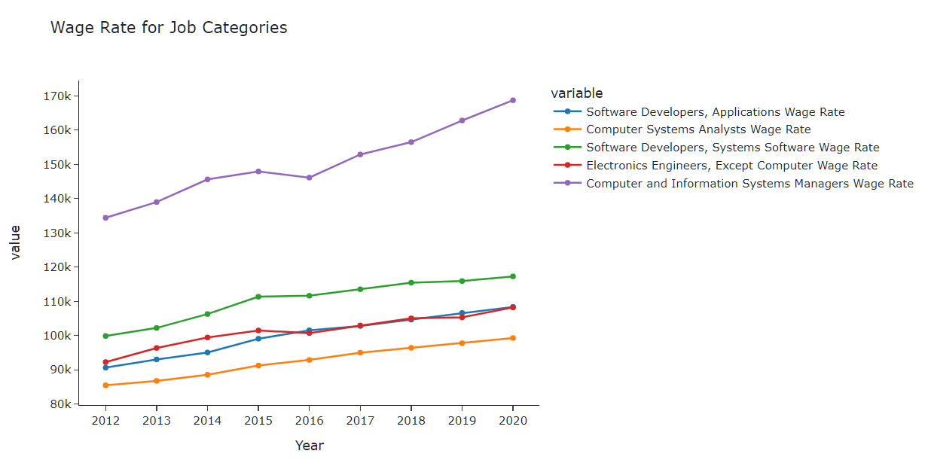
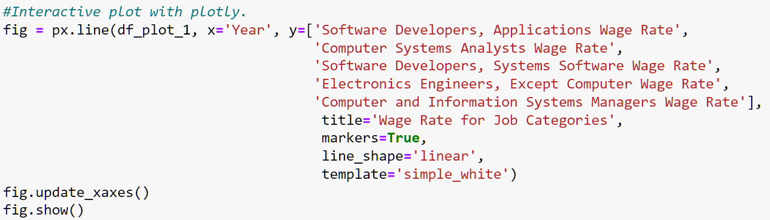
Wage Rate
Interactive Graph using Plotly

Slide 7
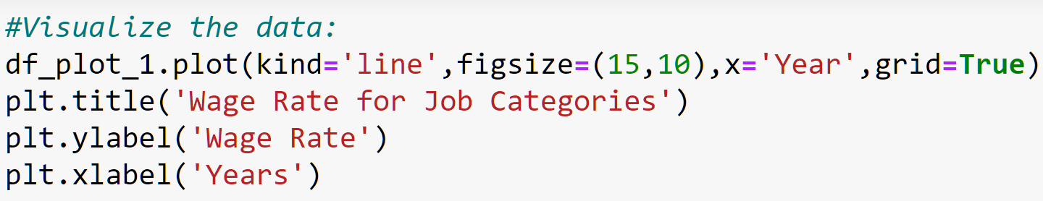
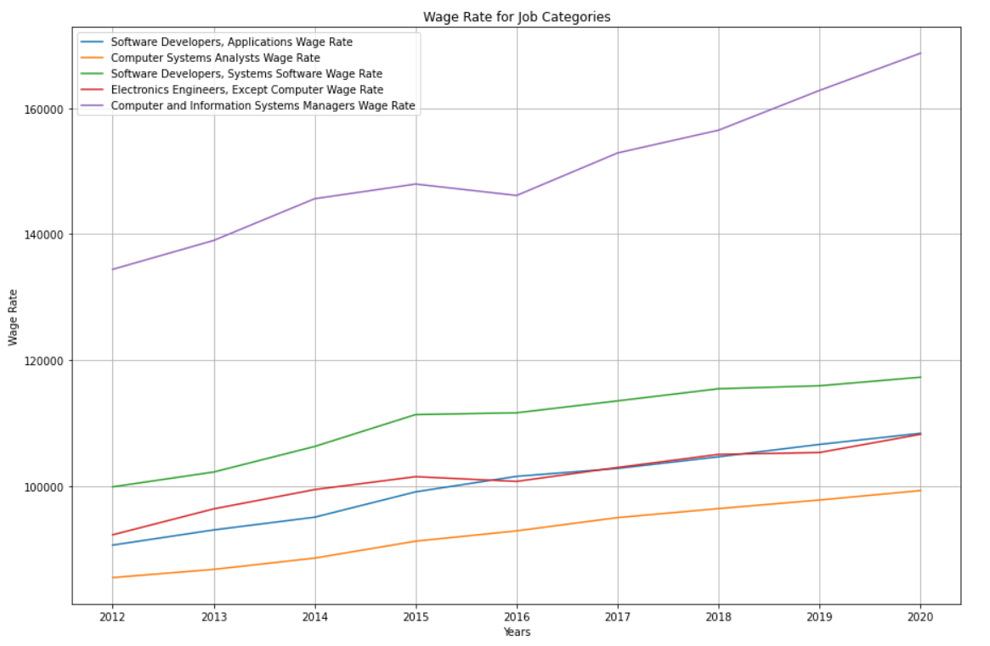
Wage Rate
Trend:
From the graph on the previous slide, we can clearly see the trend for the average wage rate for the Job Categories we selected. Wage Rate for all the jobs shown have grown throughout the years (2012-2020) by:
1) Software Developers, Applications by: 20% (2.5% YOY)
2) Computer Systems Analysts by: 18% (2.25% YOY)
3) Software Developers, Systems Software by: 17% (2.125% YOY)
4) Electronics Engineers, Except Computer by: 17.5% (2.1875% YOY)
5) Computer and Information Systems Managers by: 25% (3.125% YOY)

Slide 8
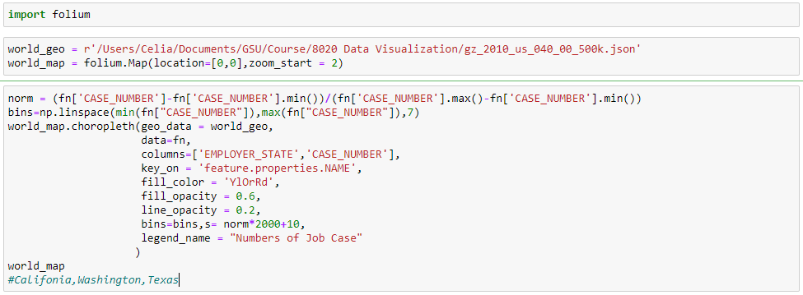
Geographic Distribution

Slide 9
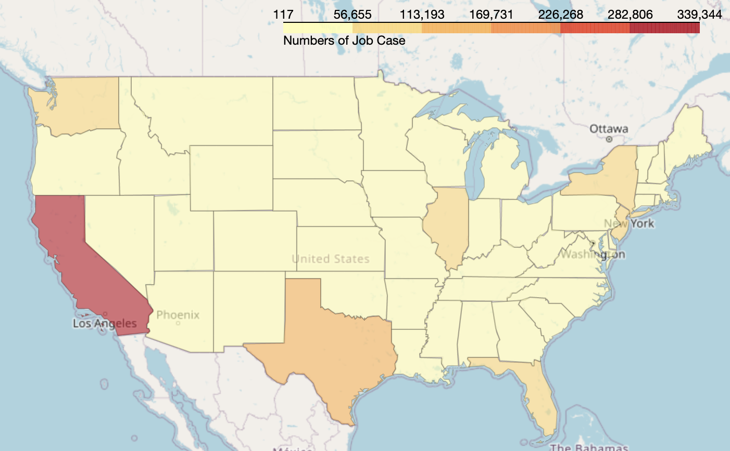
Geographic Distribution
Jobs Generated over Eight Years
Using Job Cases, we can track the number of jobs generated over 8 years
Insights
CA generated the the most job cases from 2012 to 2020
TX, NY, FL, and WA were the next top four
These states and some other cities had more job opportunities than inland areas
CA - 339,344
TX - 115,456
NY - 112,649
FL - 71,039
WA - 57,510
Change picture by right-clicking on the circle placeholder and browsing for your photo. Once the new photo has been inserted, send the photo to the back by choosing Send to Back from the Align palette. [Home tab > Arrange > Align > Send to Back.]

Slide 10
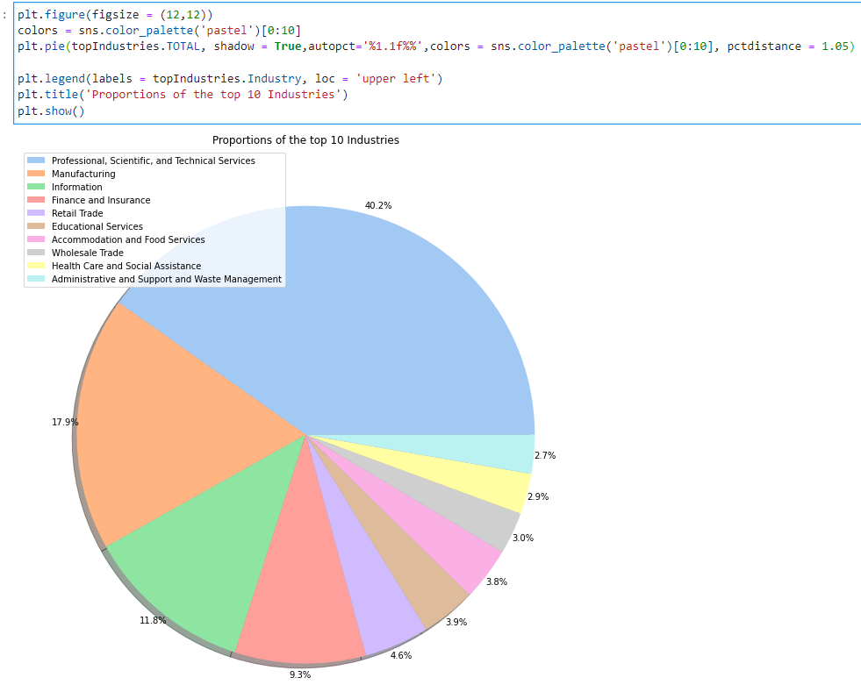
Industry Category
Pie Chart:
The pie chart displays the share of jobs in each categories across all the years.
From the chart it is clear that ‘Professional, Scientific and Technical Services’ has the highest number of jobs from 2012 to 2020.
The second highest number of jobs are observed in the Finance sector.
Professional, Scientific & Technical - 40.2%
Manufacturing - 17.9%
Information - 11.8%
Finance & Insurance - 9.3%
Retail Trade - 4.6%
Educational Services - 3.9%
Accomodations & Food Services - 3.8%
Wholesale Trade - 3.0%
Health & Social Assistance - 2.9%
Administration & Support Waste Management - 2.7%

Slide 11
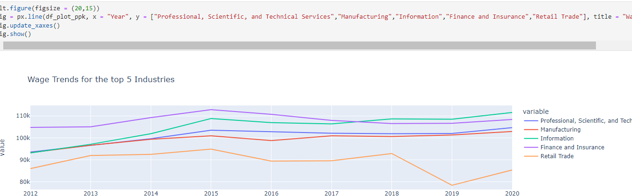
Industry Category
Line Trends For Average Wage Of Top 5 Industries
There has been a significant increase for wage rate in all the Industries except for Retail trade.
The highest wage is observed in the Finance sector.
The highest increase in wage is seen in Information sector.

Slide 12
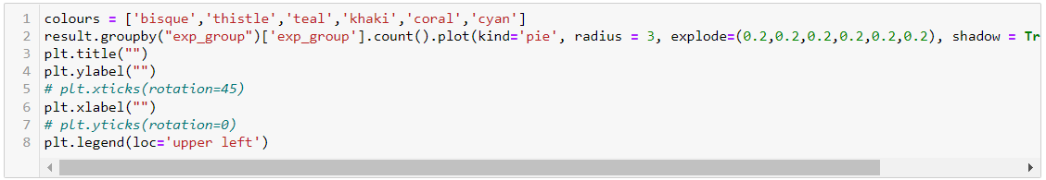
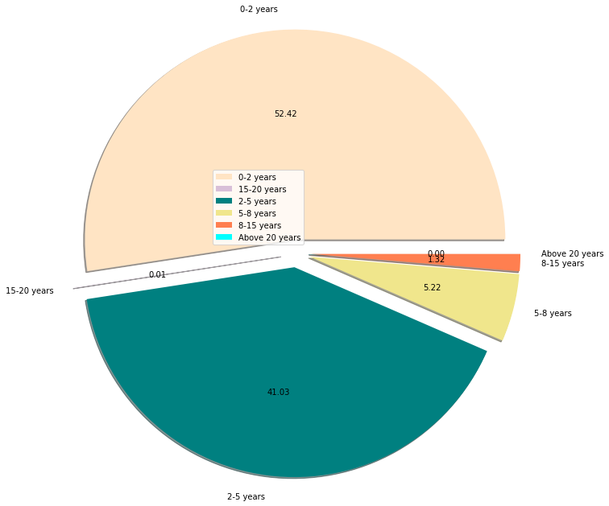
Experience
Pie Chart:
This chart shows the distribution of experience of candidates.
From the chart, it is clear that there are a lot of candidates with 0-5 years of experience but hardly any with more than 15 years of experience.
0-2 years - 52.42%
2-5 years - 41.03%
5-8 years - 5.22%
8-15 years - 1.32%
15-20 years - 0.01%
20 years or more - < 0.01%

Slide 13
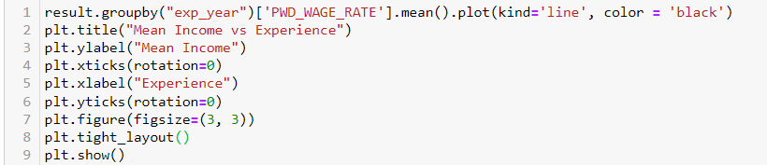
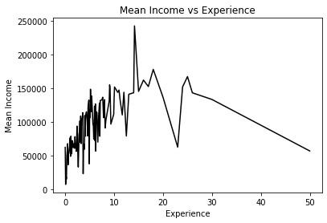
Experience vs Mean Income
Line Graph:
A line graph is drawn to compare the experience of the candidates and the mean income of the candidates having that experience.
We observe a peak in the mean income at around 15-16 years of experience.
Peak Point in Career?

Slide 14
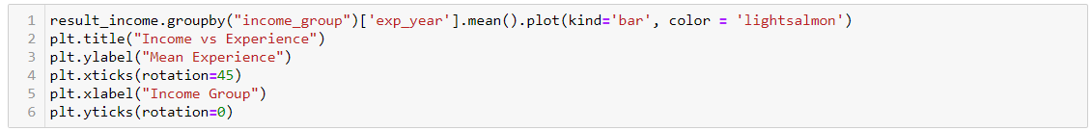
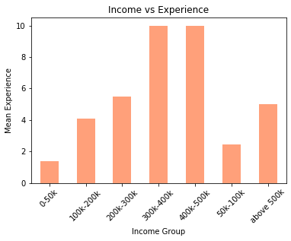
Experience vs Income Group
Bar Plot:
This plot shows us the relation between income group and experience of the candidates.
On an average, the more experience one has, the more is one’s income.

Slide 15
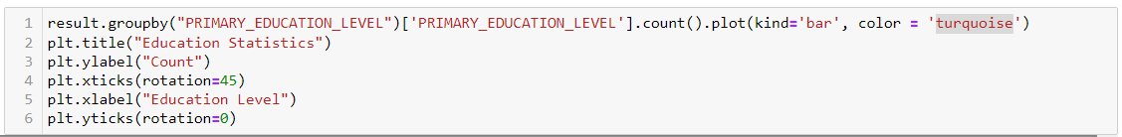
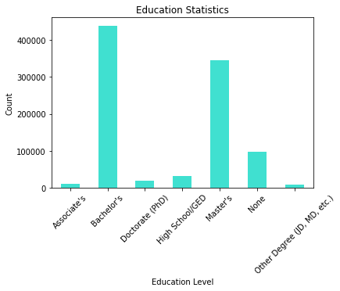
Education
Bar Plot:
This chart shows us the distribution of educational background of the candidates.
A lot of candidates either have a Bachelor’s or a Master’s degree.
Also, quite a few seem to not have any educational qualifications.

Slide 16
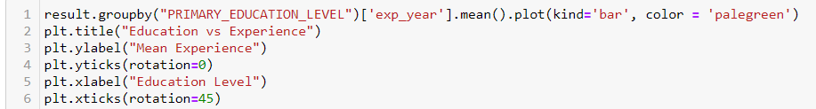
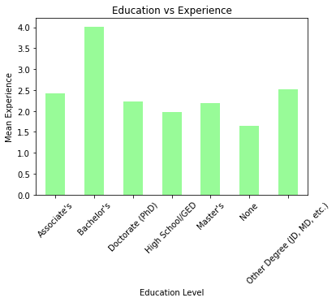
Experience vs Education
Bar Plot:
This chart compares the mean experience of the candidates and their educational backgrounds.

Slide 17
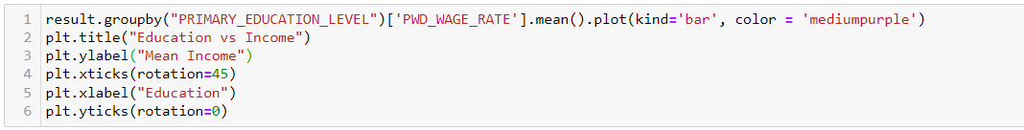
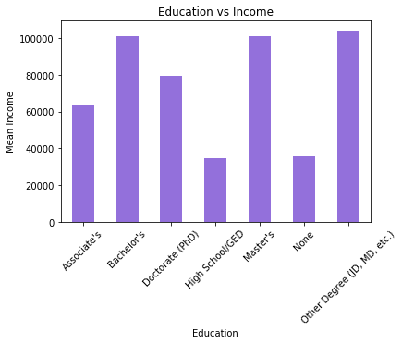
Education vs Income
Bar Plot:
This chart compares the mean income of the candidates and their educational backgrounds.

Slide 18
End
Samir Basu
Preprocessing & Project Management lead
Yash Wali
Wage Growth, Wage Rate per Job Category Data & Insights Analysis
Sijie Wang
Geographic Data & Insights Analysis
Pradyumn Pottapatri
NAICS US Code Data & Insights Analysis
Q&A
Joshua Puram
Job Experience, Education, Income Data & Insights Analysis

Slide 19
H3 – Interior Headline
First level
Second level
Third level
Fourth level
Fifth level

Slide 20
Title Only

Slide 21
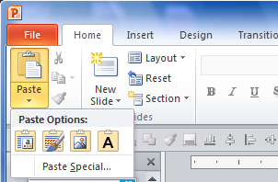
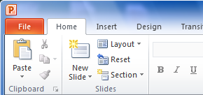
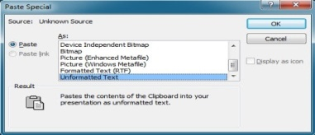
Use Specialized Paste to Bring in Text Without Formatting
Use Paste/Keep Text Only button or the Paste Special/Unformatted Text option
Copy text from its original location (Ctrl + C), then go to recipient text box, click inside and then follow one of these three options:
Click the Paste button, and under Paste Options click on the lettered clipboard button
Alternate method: right-click on the edge or frame of any text box to access a menu with the same Paste Options
Click the lower half of the Paste button then type the letter “T”
Click the Paste button and click Paste Special… In the pop-up, scroll to bottom of listed options and select Unformatted Text, then click OK
1
2
3

Slide 22
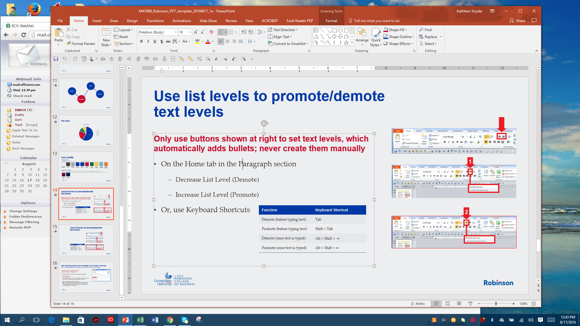

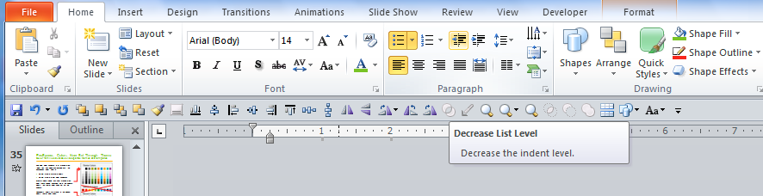
Use List Levels To Promote/Demote Text Levels
Only use buttons shown at right to set text levels, which automatically adds bullets; never create them manually
On the Home tab in the Paragraph section
Decrease List Level (Demote)
Increase List Level (Promote)
Or, use Keyboard Shortcuts
1
2
Function | Keyboard Shortcut
Demote (before typing text) | Tab
Promote (before typing text) | Shift + Tab
Demote (once text is typed) | Alt + Shift + →
Promote (once text is typed) | Alt + Shift + ←

Slide 23
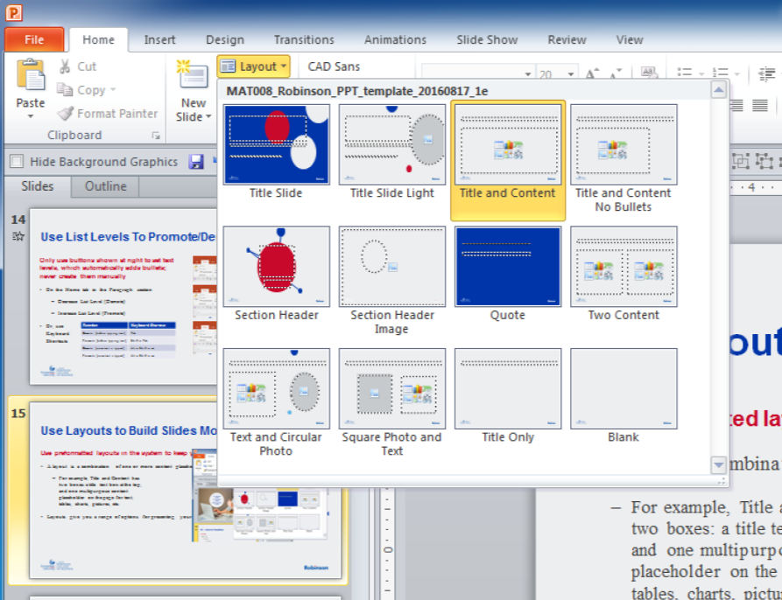
Use Layouts to Build Slides More Consistently
Use preformatted layouts in the system to keep your slides easy to format
A layout is a combination of one or more content placeholders
For example, Title and Content has two boxes: a title text box at the top, and one multipurpose content placeholder on the page for text, tables, charts, pictures, etc.
Layouts give you a range of options for presenting your information

Slide 24
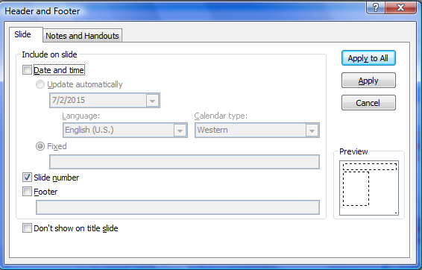
Set Slide Numbers Via Header and Footer Controls
Customize footer information via [Insert > Header & Footer]
This automatically sets footers on all master and layout pages
Do not update this information on the master layout pages
Best practice hint:
Office 2007/2010 creates live footers on pages, so bringing in slides from other files may bring in unwanted footer elements
To fix/reset all footers in the presentation: On a slide where the footer is correct, uncheck all footer elements: Date and Time, Slide Number and Footer (to turn them off) and click Apply to All, then re-check them all (to turn them back on) and click Apply to All one final time

Slide 25
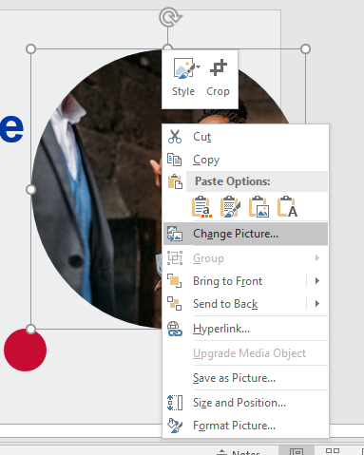

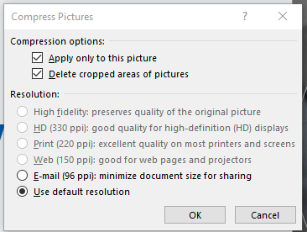

Using the Circle Photo Placeholders
Change picture by right-clicking on the circle placeholder and browsing for your photo. Once the new photo has been inserted, send the photo to the back by choosing Send to Back from the Align palette. [Home tab > Arrange > Align > Send to Back.]
Method A: Crop your existing photo to the correct size
Crop your picture to the correct size (check the photo placeholder size by right-clicking on it and choosing Size and Position)
Right-click on the default photo. choose Change Picture, and navigate to your new photo
To use square pictures in round placeholders:\
Crop the photo to the size of the circle. (4.97” x 4.87”)
Compress the photo to 220 and discard the cropped area [Picture tools > Compress Pictures]

Slide 26
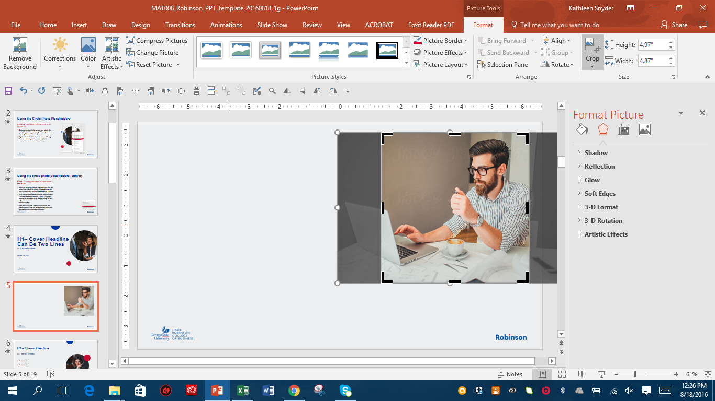



Using the circle photo placeholders (cont’d)
Change picture by right-clicking on the circle placeholder and browsing for your photo. Once the new photo has been inserted, send the photo to the back by choosing Send to Back from the Align palette. [Home tab > Arrange > Align > Send to Back.]
1
Method B: Crop your photo in PowerPoint and insert
Insert the photo on a blank slide and crop it to the correct size (check the photo placeholder size by right-clicking on it and choosing Size and Position)
With your cropped photo selected, choose Picture Tools and Compress photos. Toggle it to apply changes to this photo only, choose 220dpi or the highest resolution available, and discard cropped areas. Click OK.
Save the presentation to force PowerPoint to delete the cropped areas. Crop the photo to a circl shape.
Cut the photo and paste into the empty circular photo placeholder (click on the edge of the placeholder to select and then paste)
2
To use square pictures in round placeholders:\
Crop the photo to the size of the circle. (4.97” x 4.87”)
Compress the photo to 220 and discard the cropped area [Picture tools > Compress Pictures]
4
3

Slide 27
Color palette
Primary Palette
Text and Background Colors
Accent Colors (Chart Colors)
241-242-242 Paper White
64-64-65 Black
164-169-173 Gritty Gray
0-57-166 GSU Blue
0-57-166 GSU Blue
196-12-48 GSU Red
0-111-66 Pioneer Green
0-175-240 Vibrant Blue
151-202-235 Light Blue
239-118-34 Cool Blue
Recent Colors Palette
Additional colors. This additional palette rotates recently used colors. Colors can also be deleted if new colors are created.
119-5-32 Dark Red
0-31-91 Legacy Navy

